Slide 1
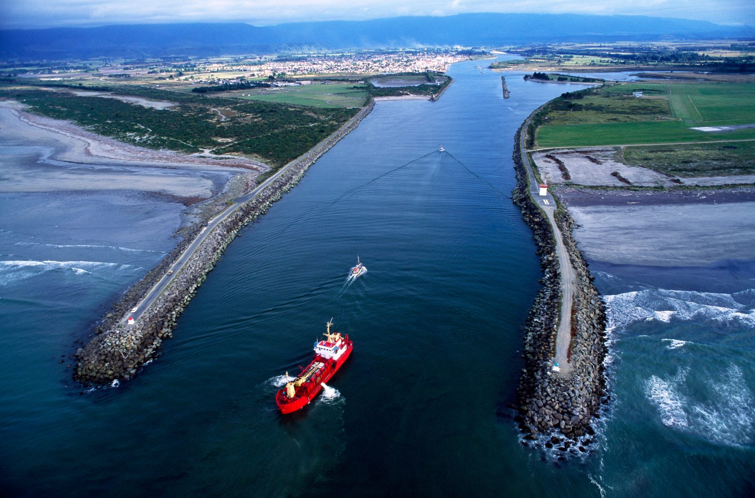
Westport Flood Scheme
Presentation to Joint Committee Meeting Wednesday 22nd May 2024
Darryl Lew, CEO West Coast Regional Council
Peter Blackwood, Chief Engineer West Coast Regional Council

Slide 2
Resilient Westport - Response to Resilience

Slide 3
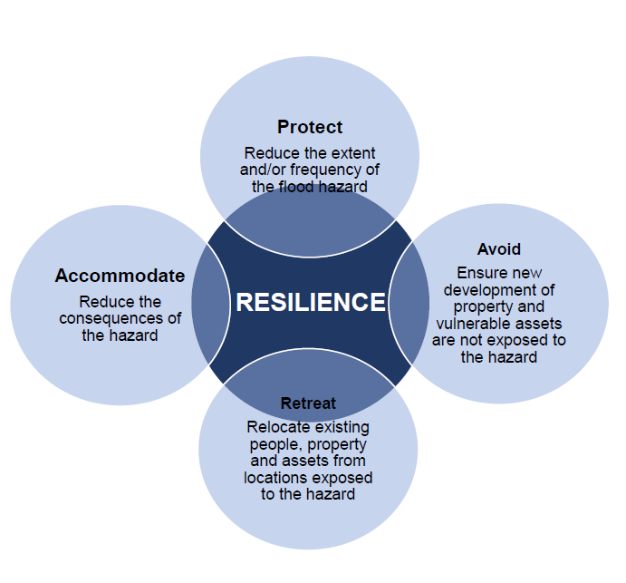
Resilient Westport - PARA Framework

Slide 4
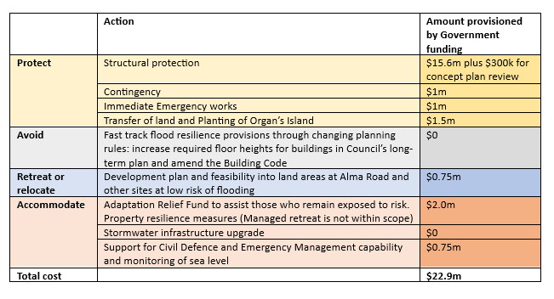
Resilient Westport - Budget Summary

Slide 5
Resilient Westport - Community Consultation & Engagement
Currently working through timeframe for Consultation and Engagement with the Community and Landowners
Westport Office – 147 Palmerston Street – still undergoing renovations
Site office for staff working on Resilient Westport Programme
Dual branding – WCRC and Resilient Westport
Front of office to be used for engagement with Community and information source for Resilient Westport projects
Opening times will be advertised for Community Engagement

Slide 6
Resilient Westport - Stormwater
No funding from Budget 23 funding - this was due to be considered as part of the last Government’s Affordable Water programme which has been repealed
BDC has commissioned a concept study relating to the Stormwater Pump Out solution as part of a fully integrated flood protection scheme
Concept study to give indicative costs of scheme
Expected completion of concept study July 2024
Funding streams to be investigated on completion of study

Slide 7
Resilient Westport - Master Planning
Led by Buller District Council, the Master Planning process seeks to provide a holistic road map for the community, public and private sector on Westport’s future growth
Three distinct stages
Vision - Better Off Funding - Complete
Concept Plan & Feasibility - Resilient Westport - Underway
Developed Spatial Plan & Implementation - TBC

Slide 8
Resilient Westport - Master Planning
Intent
Development and growth strategy
Social and economic deprivation betterment
Providing a series of options and pathways for community development
Intergenerational change – will require public and private sector funding to enable
Engagement & Communication
Workshops held every 6 weeks
Web-page and newsletters aligned with Resilient Westport
Iterative & inclusive design process

Slide 9
Westport Flood Mitigation Stopbanks
Insurance Industry
AIG
Official Information Request
Insurance Retreat
Risk-Based Insurance
Benefit of New Scheme

Slide 10
Westport Flood Mitigation Stopbanks
Contents
Major Developments
Scheme Description
Progress to Date
Next Three Months
Planned Overall Construction Programme
Total Cost Estimate
PARA WORKS – Flood Forecasting & Organs Island

Slide 11
Westport Flood Mitigation Stopbanks
Major Developments
June 2022 Proposal to Hon Nanaia Mahuta Minister of Local Government – Co-Investment in Westport’s Resilience.
The Kawatiri Business Case was a case to Government to co-fund Westport’s resilience. It provides a multi-tool approach to Westport’s flood resilience. Also described as the Multi Tool Resilient Westport Business Case.
Mid 2023 Government Approval from Hons Grant Robertson & Kieran McAnulty for $22.9 million across all PARA activities. PARA is: Protect, Avoid, Retreat and Accommodate
Included $15.6 million for flood mitigation stopbanks and $0.3 million for Independent Review of Tonkin & Taylor report.
September 2023 Te Uru Kahika, representing the Regional Councils and Unitary Authorities of New Zealand reviewed the Tonkin & Taylor Report. Favourable finding on proposed scheme (next slide).
Following multiple discissions with Department of Internal Affairs on 18 April 2024 Hons Nicola Willis & Simeon Brown confirmed that Government had approved the drawdown on the remaining funds with the total of $22.9 million. Available over next two financial years.

Slide 12
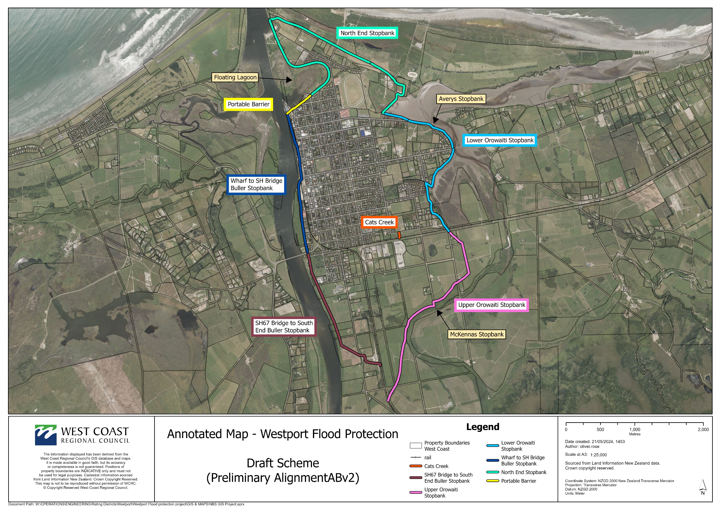
Westport Flood Mitigation Stopbanks - Draft Scheme

Slide 13
Westport Flood Mitigation Stopbanks
Scheme Description
Various Components:
Stopbanks, “Planter-Box “ Stopbanks, Concrete Floodwalls, Wooden Floodwalls, Professional Flood Barriers (near Talleys)
Total length around 16 km (excluding Carters)
Carters to be determined
Design standard generally 1% AEP with climate change under RCP6.0 (NIWA advice) and 600mm freeboard
Averys 1% AEP with 200mm for climate and 600mm freeboard
A 1% AEP flood has a 1 in 100 chance in any given year
Freeboard is engineering provision for estimate accuracy and other factors not included (waves, aggradation, debris etc)
Heights generally around 2 metres, Maximum height 3.6m

Slide 14
Stephen Road
Brougham Road
Coates St/Tiphead
Upper Orowaiti Stopbank
North End Stopbank
Lower Orowaiti Stopbank

Slide 15
Wharf
Buller River Bridge

Slide 16
Westport Flood Mitigation Stopbanks
Progress to Date (1)
Very significant progress on implantation of 4 Stage One designs(previously called “Quick win” – Cats Creek, McKenna’s, Avery’s and Floating Lagoon
Environmental Assessments completed on first two (ecological, landscape, planning)
Draft engineering design report completed on all four
Initial geotechnical designs completed on all four
Final geotechnical designs well advance on McKenna’s
8 Boreholes Drilled – very initial findings from consultant Davis Ogilvie are that the groundwater is tidal all the way to McKenna’s, though groundwater >3m below ground there
Advice received from Consents that Cats Creek does not need Resource Consent

Slide 17
Westport Flood Mitigation Stopbanks
Progress to Date (2)
Lengthy consultation with KiwiRail well advanced and reaching a favourable conclusion
Ongoing consultation with landowners briefly paused whilst geotechnical studies confirm stopbank batter slopes
WSP Consultants roughly 50% completed on assessment of flood level mitigation options at Buller SH67 Bridge.
IMPORTANTLY Construction Engineer Jordan Mandery has commenced duties. Jordan brings a good set of experience in flood mitigation works construction. Wide-ranging skill set.
Initial assessment on impact of flood levels on properties outside scheme
Significant progress made on finalizing design alignments for works in 2024/25 year. Interactive with previous bullet point.

Slide 18
Westport Flood Mitigation Stopbanks
Next Three Months
Construction of Cats Creek Stopbank
Remediation of lowered section of stopbank near Floating Lagoon and vegetation clearance at Floating Lagoon
Completion of geotechnical design on McKenna’s & Avery’s
Final plans, landowner agreements and consents for McKenna’s
A good start on McKenna’s stopbank construction
Final Design on Avery’s
Completion of assessment of flood level mitigation options at Buller SH67 Bridge
Preliminary design on other 2024/25 works including initial design on Buller River stopbank upstream SH67 Bridge
Possible advancement of options assessment for Carters Beach flood mitigation

Slide 19
Westport Flood Mitigation Stopbanks
Planned Overall Construction Programme
2024/25
Buller upstream of SH67,
Avery’s
Upper Orowaiti (including balance McKenna’s)
Floating Lagoon & Professional Portable Barrier near Talleys
2025/26
Lower Orowaiti (excluding Avery’s)
Buller downstream of SH67 through to North End
Drains & Stormwater provision
2026/27
Carters Beach (to be confirmed)

Slide 20
Westport Flood Mitigation Stopbanks
Total Cost Estimate
Government Share $15.6 million
WCRC Share $ 8.37 million
Total $23.97 million

Slide 21
Westport Flood Mitigation Stopbanks
PARA WORKS – Flood Forecasting & Organs Island
Flood Forecasting
NIWA Flood Forecasting Model Fully Operational
Model produces estimates of flood levels in Westport based on recorded rainfall and forecast rainfall through upstream catchment
Produces real time flood maps for Emergency Management
SOFA wave recorder buoy purchased and ready to deploy. Will give real time wave heights and periods (time between waves) for boats
New water level gauge installed Orowaiti Lagoon. More gauges planned
Organs Island
Organs Island to be planted up
Aim is to restrict outflows through to the Orowaiti. The best balance for flood mitigation is to retain slightly more flows in the Buller River

